Slide 1

Road Map for Space Harness
11
Vision and Opportunities for DC Harness Technologies
Marc Malagoli, Senior Expert in EWIS*, Electrical Architecture & Electrical Connectivity
marc.malagoli@airbus.com
16 October 2024
* Electrical Wiring Interconnection System

Slide 2


Usual Vision of the Electrical System
A Monster is hiding there!
Image generated by AI

Slide 3
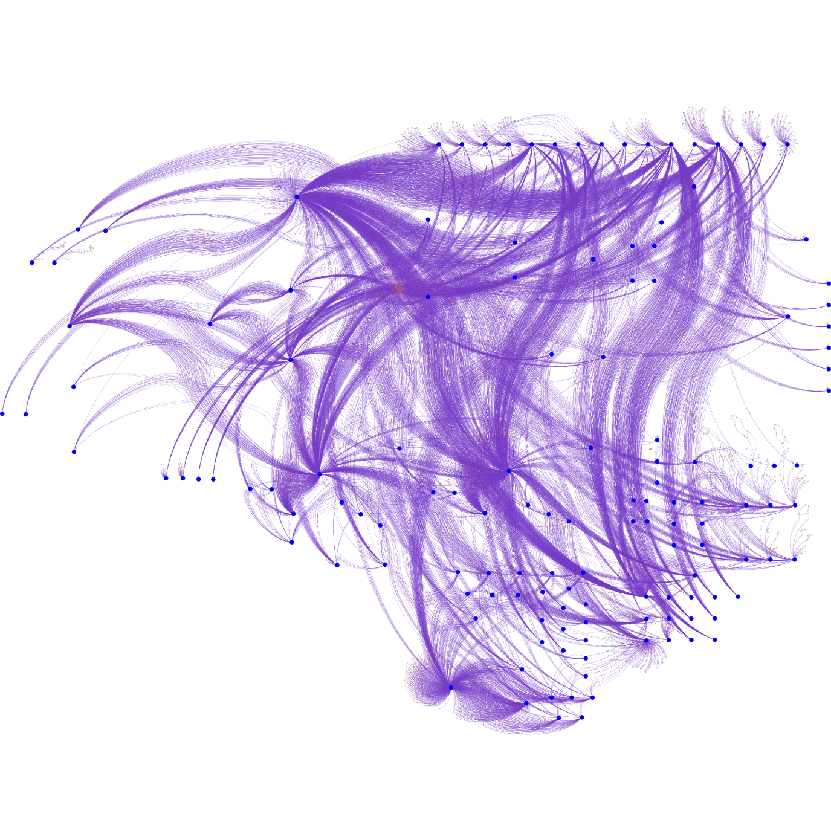
Interconnections!

Slide 4
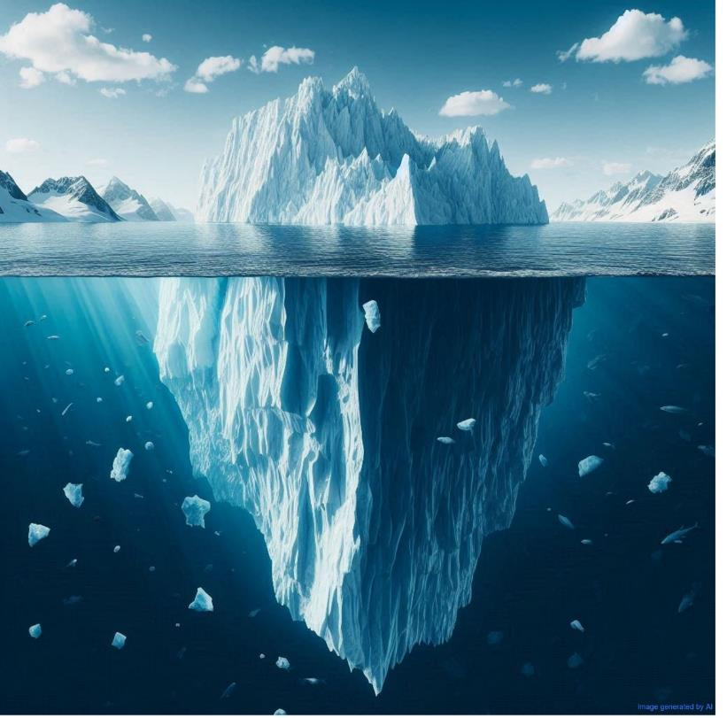
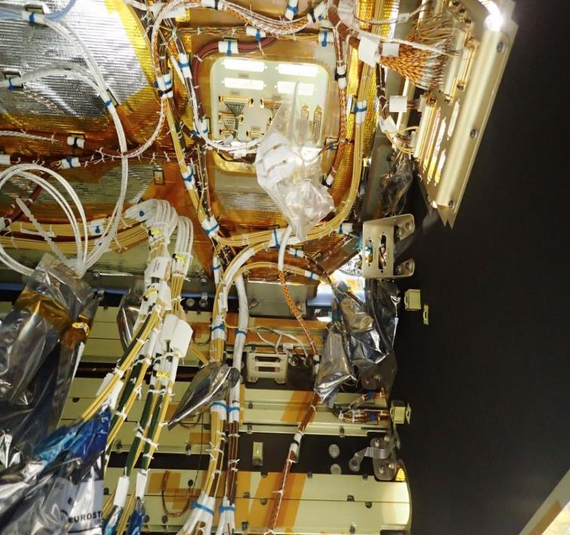
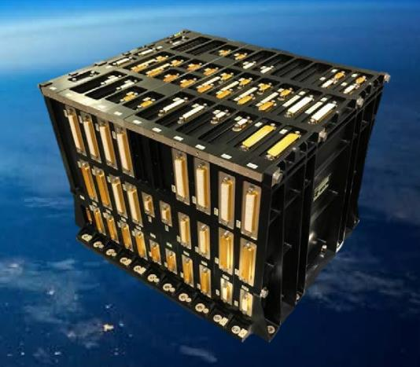
The Visible part : The Harness
Up to 70 000 connections
100 to 250kg
Critical Schedule
Complex Accommodation & Installation
Automation is not feasible for
Space harness
Hundreds of connectors
Complex and large PBC’s

Slide 5
The Hidden Costs of Interconnection Complexity
Airbus Amber
Big efforts to Design, install and Validate
Definition of Electrical Architectures, Units Interfaces, Spacecraft accommodation, Test procedures
Specific analyses: EMC, thermal control, high voltage, failure modes
Industrial Nightmare:
Interfaces and interconnections require vast data, lots of stakeholders, and multiple iterations. On the critical path,
Performance penalties
Mass, volume
Assembly & Tests: risks of damage, anomalies management
Huge cost spread on the whole project,
globally undocumented
Notes:
Revoir

Slide 6
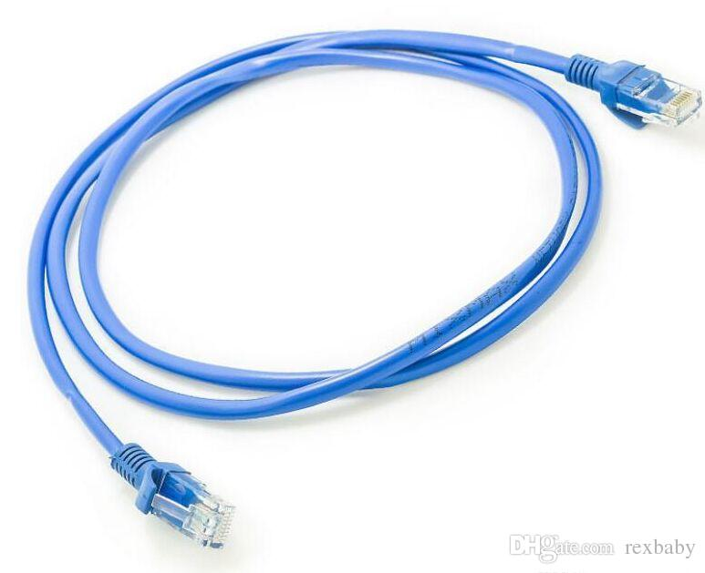
The Vision
Dream of highly flexible electrical architectures,
enabling quick and cost-effective design for optimized space systems…
… Then develop building blocks to realize this vision
using commonplace ground technologies.

Slide 7
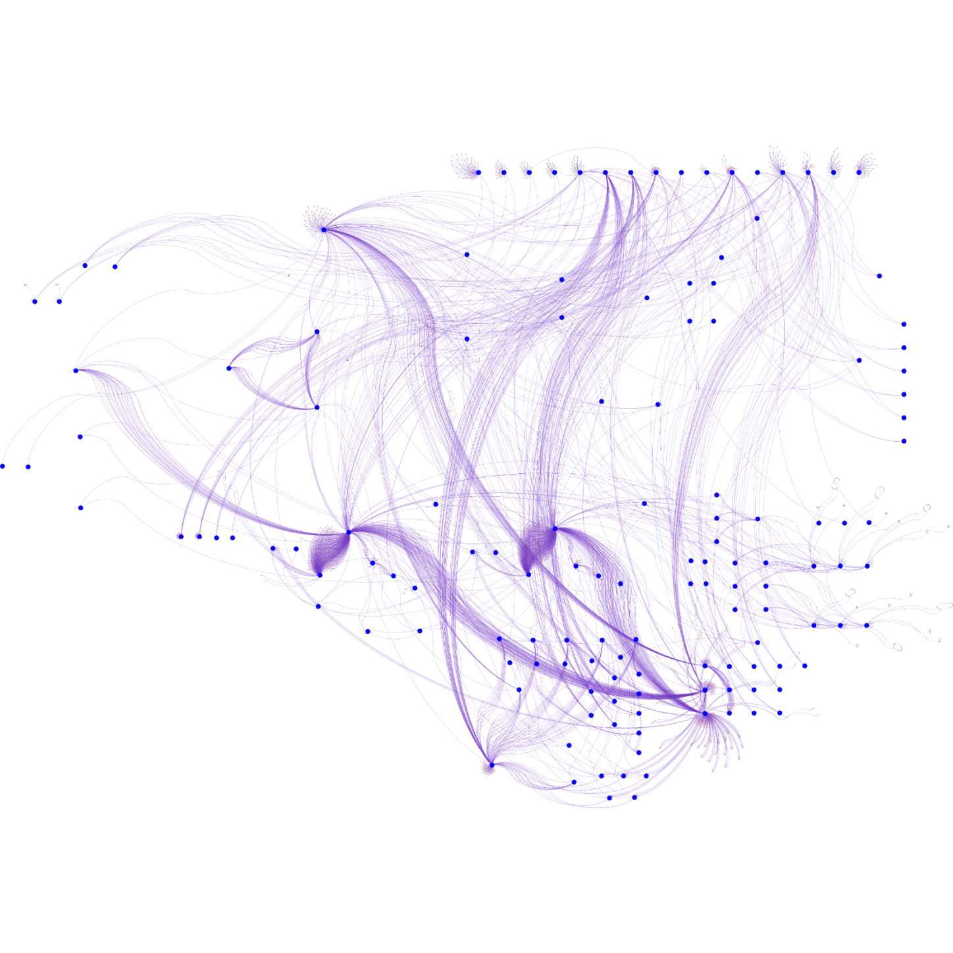
The Dream
Minimal Connectivity
Enhanced Features

Slide 8
Complex to Simple : the gains
A few building blocs for lots of features
Simple to design
Reduced Cost
More Reliable
Easy to validate
EMC friendly
Low mass
Re-USE Building Blocs
Modern technologies
Easy changes
Less connectors on PBC’s
Short Lead time
Improved performances
Simplicity is the best way to achieve quality while reducing costs and lead times.

Slide 9
How - principles
Power:
Connect Sources,
Distribute to electronics & Thermal Control
Interconnections have Two primary uses
Interdependence
Data:
Transfer Commands, Sensors, Payload Data
The “DC” electrical interface of most of the units
should look like this:
Power
Data bus
Electrical Unit
Notes:
Revoir schéma

Slide 10
Reconsider our architectures for low connectivity
Some Guidelines
Moving functions to reduce interconnects:
Split or merge units.
Challenge the location of switching, protections, power and signal conditioning…
Make the units smart and autonomous (battery, equipment’s, actuators, heaters…)
Transitioning to fully digital on-board data transfer:
Onboard, data is often transmitted in analog form between units although it is eventually digitalized for computer and telemetry use.

Slide 11

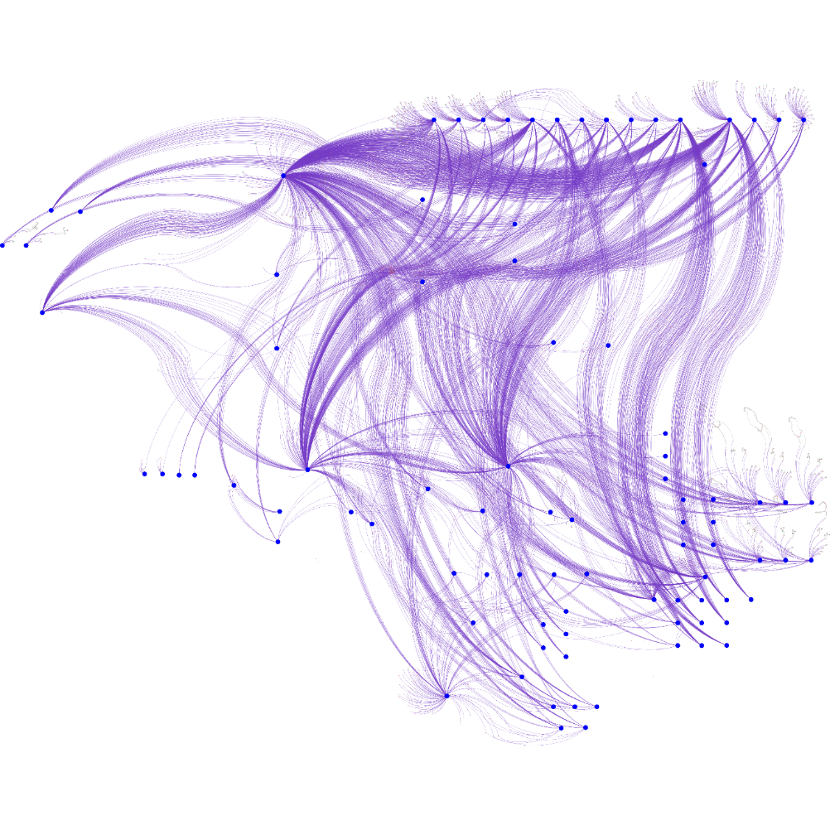
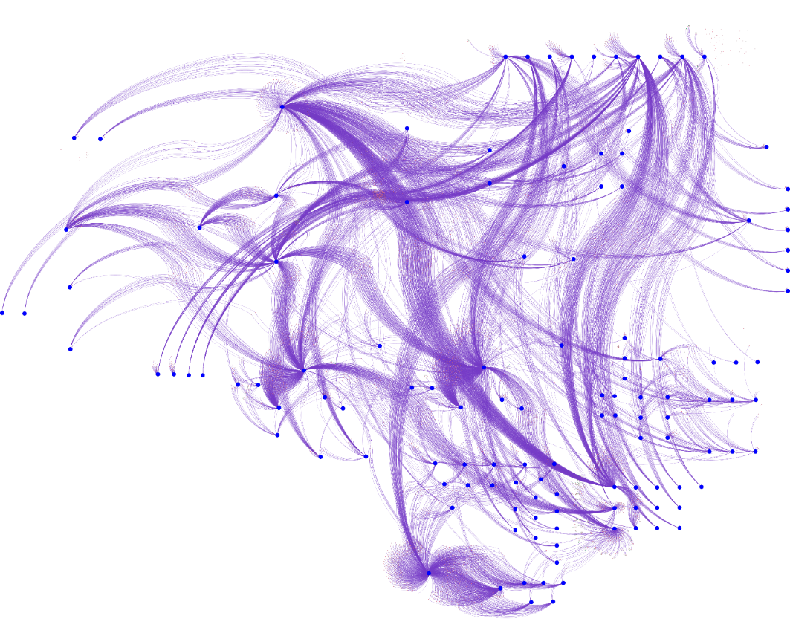
Thermal Control accounts for over 30% of the total interconnections
Thermal Control
Other
Huge Total Cost of Ownership:
Complex Design
Lots of discrete components
High Installation workload & lead time
Need to seek further optimization between
Electrical, Mechanical and Thermal control systems

Slide 12

For every complex problem, there is a solution
that is simple, obvious, and wrong *
Why not Wireless ?
* Freely inspired by a quote from H.L. Menken – Image generated by Human Intelligence

Slide 13
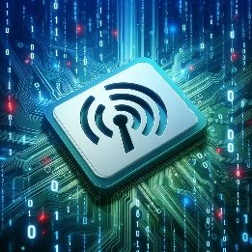
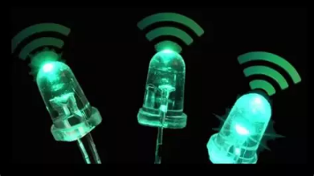
"Less wires" does not necessarily mean “Wireless."
A “wireless” link is still an interconnection, and a costly one!
Some wireless drawbacks:
RF (e.g. Wifi, RFID…):
  Electro Magnetic Compatibility concerns
  Susceptibility to jamming, spying
  Coverage within the spacecraft (may need several transceivers or antennae)
Optical (e.g. LiFi):
  Field of view
  Limitation on bandwidth
  Number of channels
Wireless is NOT a universal solution for onboard data transfers,
but it might benefit specific uses, like mechanisms and appendices.

Slide 14
Projections for Space Passive Components

Slide 15
Transition from individual onboard signals to data bus transfers.
    Digitalization, a major trend since the '90s, remains a work in progress.
    Main gaps:
    Data digitalization
    To use digital sensors as far as possible.
    To digitalize more signals inside the units.
    To replace remaining relay boxes with solid-state components (Mosfets, LCL shall be generalized).
    On-Board Data Transportation
    Current data link offers are suboptimal, with numerous standards, inferior performance to ground-based state-of-the-art, high costs, and EMI sensitivity. (Mil-STD-1553, SpaceWire, LVDS, RSxxx, CAN…)
    Harness evolution should lower costs for faster, higher-volume data transmission.

Slide 16
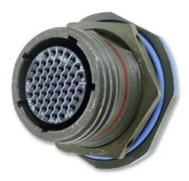
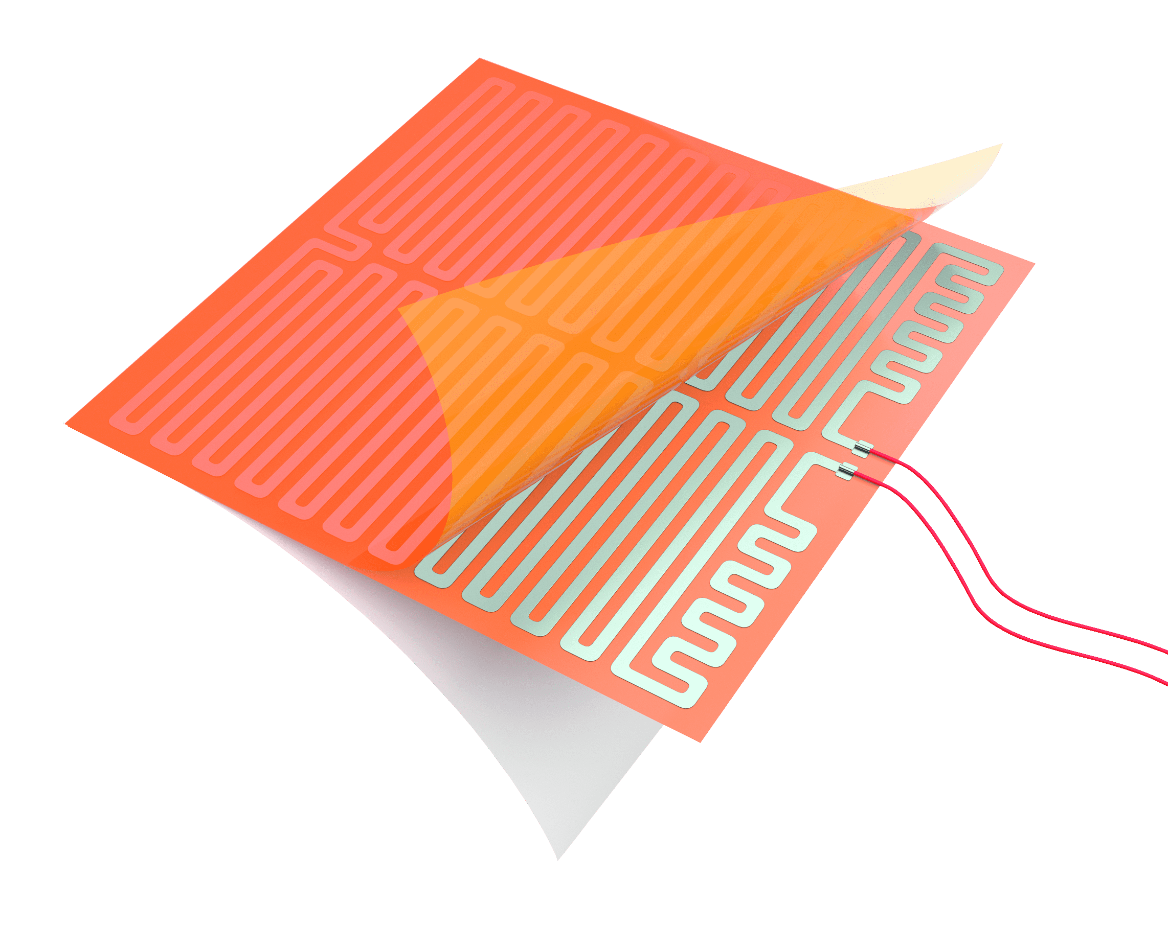
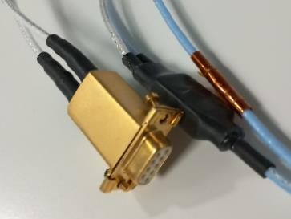
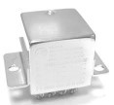
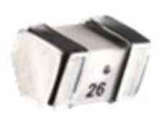
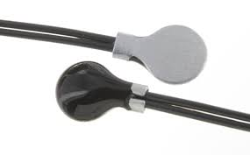
Expected Evolution on Passive Component
Less harness
  Connectors, splices,
  Cables, especially for signals
  Coax
  Fastening materials…
Less discrete elements
  Thermisters
  Heaters
  Relays
  Fuses
https://zoppasindustries.com/it/resistenze-elettriche-flessibili/
http://www.meas-spec.com/

Slide 17
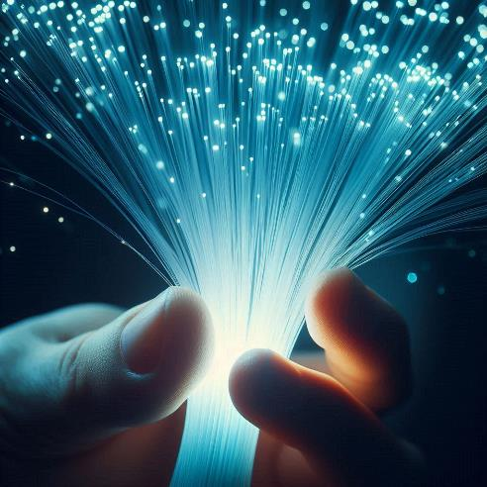
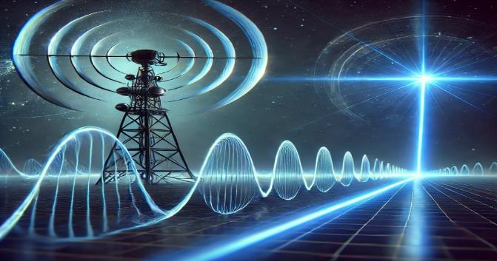
Photonic as a promising game changer
  A "one-size-fits-all" photonic solution could standardize all on-board end-to-end data transfers.
  The Photonic Standards should cover some passive components:
    Fibers
    Cables
    Connectors: internal & external, adaptor
    Fiber optic Flex
    Splitter, Coupler, Fan-out
    => GSTP “End-To-End On-Board Data Handling Architecture Based On Optical High-Speed Links”
    (Kick-off expected in November 2024).
Image generated by AI
    "RF over Fiber" technology
    is as well projected
    to replace coaxial links
Image generated by AI

Slide 18
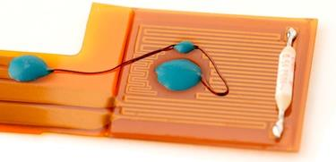
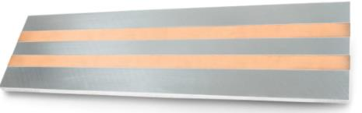
Expected Evolutions on Passive Component, Thermal Control & Structure
Simplified interfaces
  The unit's interface should be designed based on external connections to enable harness automation.
  E.g.:
    Try to limit to 2 connectors: 1 power + 1 data
    1 wire per contact, no splice, minimize shieldings
  More Fast lock connectors
  New building blocs, passive and/or active
  Smart hardware
    Smarter electronic units (integrated thermal control, digital interface)
    Smart heaters (active or passive including heaters + thermal regulation)
    Smart structures
      Embedded flat cables
      Embedded thermal control
      Embedded components
  New technologies
    Digital or photonic Sensors (thermal, strain, position…)
    MEMS
    Conductive printing,
    Additive manufacturing for conductors
https://www.minco.com/minco-offers-heaters-with-embedded-sensors/
Need of Standards

Slide 19
Conclusion: Disruptive changes to come, Long Term, Support needed…
Our architectures are hampered by overly complex interconnections, leading to high costs, long lead times, and quality issues. Incremental changes to harness technologies without revising our systems and avionic won't provide major benefits.
We can drastically reduce this complexity by rethinking our systems, challenging each interconnection and using new components.
To achieve disruptive advancements, we should focus on digitalizing unit interfaces, using optical data transfer technologies (fiber optics), reshaping thermal control approaches, and embedding electrical functionalities into mechanical structures.
This will require to qualify components already common in ground applications including passive ones like optical fiber harness, digital and optical sensors, flat conductors, and we expect to require fewer conventional harness parts.
We encourage our partners to help identify and suggest components that could further help us minimize interconnections.
Given the difficulty of qualifying such technologies within a program's timeframe, Space Agencies support is essential to advance technology readiness levels (TRL) and make them acceptable for project managers in first flight applications.

Slide 20
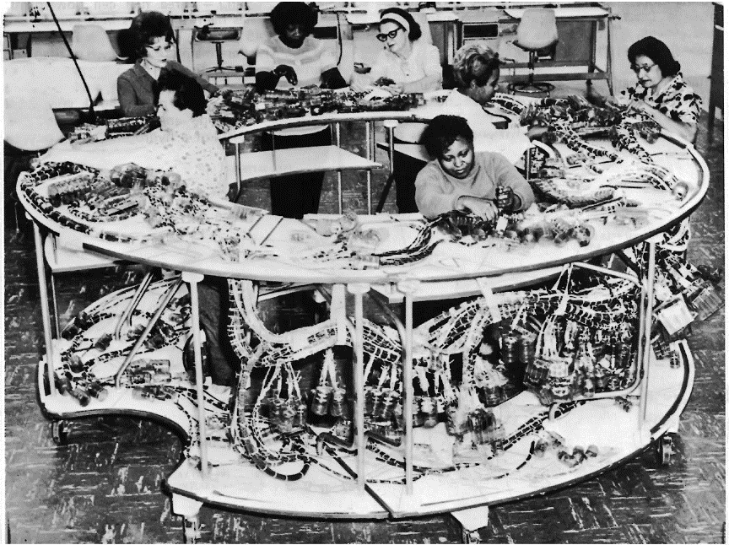
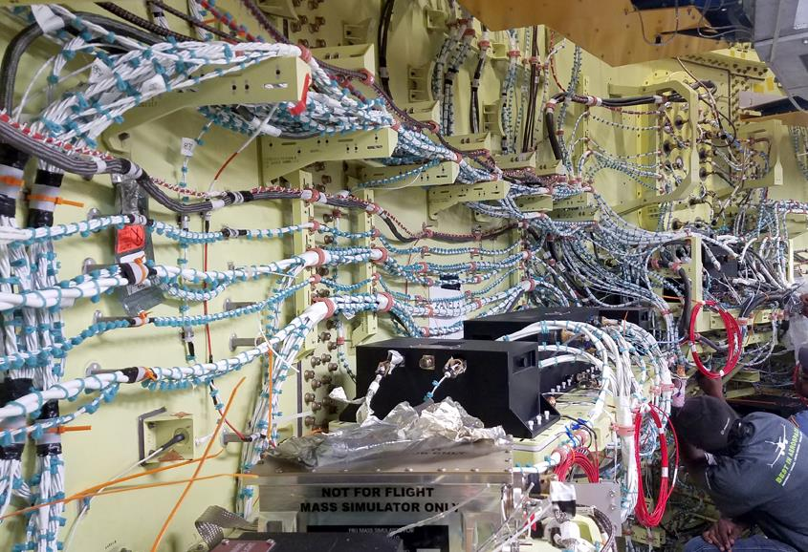

It takes time to change but it is time to change!
1969 - Apollo Command Module
2024 - Nasa Space Launch System
Me
in 1969!
Command module on mockup stand – ref: APOLLO SPACECRAFT NEWS REFERENCE – Space Division of North American Rockwell Corp
https://commons.wikimedia.org/wiki/File:Em-1_intertank_cables.jpg
Passive components will be key contributors.
school notebook

Slide 21
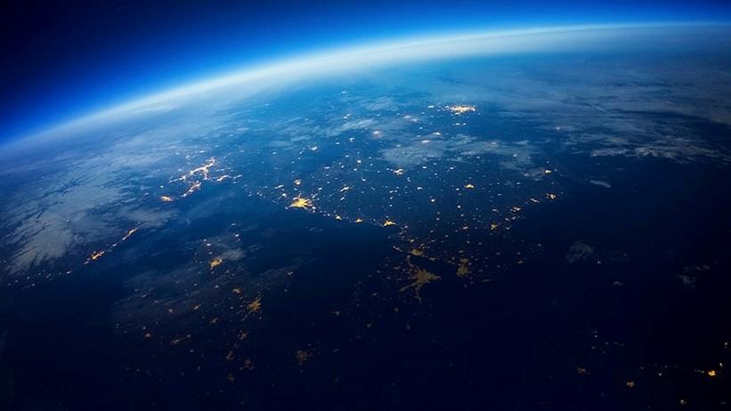
Thank you for your attention
Your questions are welcome!
Contact: Marc.malagoli@airbus.com

